Slide 1

Road Collision Severity Prediction in Seattle

Slide 2
Introduction
Machine learning algorithms have been developed to predict accident severity using Seattle collisions data.
The accident severity varies based on a wide range of factors, including weather conditions, light conditions, speeding, etc.
Analysis of collisions data enables us to determine the severity of road accidents under different conditions. Therefore, restrict regulations or warning systems can be designed to reduce road traffic injuries and fatalities under high-risk circumstances.

Slide 3
Data
City of Seattle has released an open source dataset containing all types of collision since 2014 to present. This dataset is updated weekly. The dataset contains 221738 rows, each of them reperents a collision sample. Also, it contains 40 columns:
39 features (independent variables), and
"SEVERITYCODE" as the dependent variable which is going to be predicted based on the provided features.
In this dataset, the accident severity ("SEVERITYCODE") is divided to 5 categories:
0: Unknown, 1: Property Damage Only Collision, 2: Injury Collision, 2b: Serious Injury Collision
3: Fatality Collision

Slide 4
Data Pre-Processing
The following actions have been performed to preprocess the data before feeding it to the models:
feature selection, removing non-relevant columns to the prediction task, avoiding multicollinearity
removing NULL or NaN values if it is needed
converting categorical variables to numerical variables
performing standardization to bring the features on the same scale
balancing the data (different accident severity types have different number of samples in the dataset)

Slide 5
Methodology
To predict accident severity using Saettle collisions data, following machine learning algorithms have been employed to classify the accident severity as one of 5 existing categories:
K-Nearest Neighbors (KNN)
Decision Tree
Naive Bayes
Random Forest
Logistic Regression

Slide 6
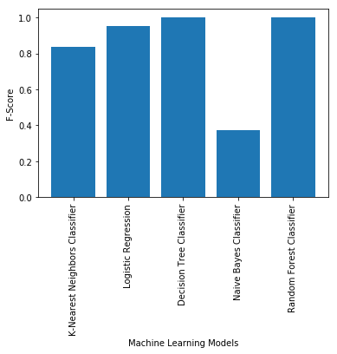
Results

Slide 7
Conclusion
Machine learning algorithms are powerful techniques as predictive models. Using the collision severity prediction, appropriate safety guidance can be designed to decrease property damages, injuries, and fatalities.

